Slide 1
PCI DSS Security Awareness Training for Credit Card Merchants at The University of Tennessee and The University of Tennessee Foundation
Presented by
UT System Administration Information Security Office

Slide 2
Agenda
PCI DSS Overview
PCI DSS Compliance
Merchants’ Roles & Responsibilities
Identifying & Reporting Data Breaches
POS Terminal Fraud & Protection
Merchants’ Annual Obligations

Slide 3
PCI DSS Overview
PCI DSS is the Payment Card Industry Data Security Standards.
PCI DSS requirements are applicable to all merchants who process, transmit, or store cardholder data, regardless of the size or number of transactions.
PCI DSS requirements also apply to all third-party service providers.
The payment brands (e.g., VISA, MasterCard), as well as the acquiring banks (e.g., Elavon, FirstData) are responsible for enforcing PCI compliance.

Slide 4
PCI DSS Security Training Requirements
Every person involved in processing cardholder data is required to complete annual PCI DSS security training.
This includes all students employed by the merchant, if credit card processing is part of the job.
This training will help you meet the following requirements:
Requirement 9.9.2
Requirement 9.9.3
Requirement 12.6

Slide 5
Maintaining PCI Compliance
PCI DSS compliance is not optional!
Be able to honestly answer “Yes” to each requirement in the SAQ that is appropriate to your merchant processes.
If you answer “No” for any sub-requirement, you must have a plan of action and date for remediation.
Follow only those processes for which you have been approved.
Contact the Treasurer’s Office or the UTSA ISO should you have any questions or concerns about compliance.

Slide 6
The Cost of Non-Compliance
Suspension of merchant account(s)
Fines to be paid by the merchant
As high as $500,000 per data security incident
As high as $50,000 per day for non-compliance with published standards
All fraud losses incurred from compromised account numbers to be paid by the merchant
From the date of the compromise forward
Cost of re-issuing credit cards to be paid by the merchant

Slide 7
The Cost of Non-Compliance
Increased transaction fees charged by the bank to be paid by the merchant
External incident investigation to be paid by the merchant
Estimated cost is $30,000 - $300,000 per incident investigation
Remediation costs to be paid by the merchant
Legal fees, settlements, and judgments to be paid by the merchant

Slide 8
The Cost of Non-Compliance
One compromised UT (UTFI) merchant can adversely affect the remaining merchants throughout the entire system.
Random external audits by a PCI Security Standards Council-certified assessor for any UT (UTFI) merchant
Change in merchant level or SAQ type
Remember that the University’s and Foundation’s reputations are at stake!
Loss of sales and loss of donations as customer confidence declines
Possibly a far greater loss than any fines or fees
Longer recovery when repairing reputation

Slide 9
PCI Policies
Read and follow UT’s FI0311 – Credit Card Processing.
Fiscal and IT policies are available on the UT Policy website: http://policy.tennessee.edu
Maintain and follow internal policies and procedures.
Merchant internal documentation templates are available on the PCI Compliance website: http://security.tennessee.edu/pci-dss-compliance-information/.
Regularly review these policies and standards:
IT0110 – Acceptable Use of Information Technology Resources (AUP)
IT0115 – Information and Computer System Classification
FI0120 – Records Management
UT’s PCI DSS Incident Response Plan

Slide 10
FI0311: Roles & Responsibilities
Merchants (Departments/Units)
Complete annual SAQ and maintain compliance at all times
Notify Treasurer’s Office and campus CBO of any proposed change in approved processing
Maintain internal documented policies and procedures
Maintain PCI inventory list
Complete annual PCI security training

Slide 11
FI0311: Roles & Responsibilities
Merchants (Departments/Units)
Protect cardholder data and ensure appropriate security controls
Technical controls on computers that process PCI data
Terminal (POS) software is always up-to-date
Computers are in the segmented cardholder data environment (SAQs A-EP, B-IP, C, C-VT, D)
Computers/servers serve only one function…PCI
Notify campus CIO when there are changes to system resources
Financially responsible for all costs associated with compliance, including fines, fees, and remediation expenses

Slide 12
Primary Causes of PCI Data Breaches
Being non-compliant with the PCI DSS requirements
Attacks on users
Malware
Man-in-the-middle attacks
Default or guessable passwords
PCI devices used for non-PCI tasks
PCI devices using Wi-Fi networks
Physical tampering of unmanned or unattended POS devices
Remote access
Unpatched systems

Slide 13
Detecting a Suspected Data Breach
Anti-virus programs malfunctions or becomes disabled for no apparent reason
Excessive failed login attempts
Unexpected system reboots or shutdowns
Unexplained user accounts

Slide 14
Detecting a Suspected Data Breach
Suspicious after-hours activity on PCI devices
Unexplained modification or deletion of data, such as event logs
Unknown files, software, and/or devices installed on PCI systems, including archived, compressed, or encrypted files in system directories
Unknown or unexpected network traffic

Slide 15
PCI Incident Response
Do NOT turn device(s) off, but unplug only the network cable.
Do NOT make any changes to device(s)!
Immediately report any suspected security incident to UTSA ISO and your campus/institute CIO.
May be computer, network, or paper-based activity
May result in
Loss of confidentiality
Compromise of integrity
Loss of availability
Label approved PCI devices to help identify what not to touch in the event of a suspected security incident.

Slide 16
POS Terminal Fraud
Skimming
Stealing payment data from the customer’s credit card
Stealing payment data from the payment infrastructure
Cloning and PIN harvesting
POS malware and man-in-the-middle attacks
More prevalent with EMV devices
Malware used to intercept random number assigned during the transaction, replacing it with a different pre-computed number
POS fraud targets
PIN data
Unattended or unmanned terminals
Merchants with a high transaction volume
Merchants with periods of high volume sales

Slide 17
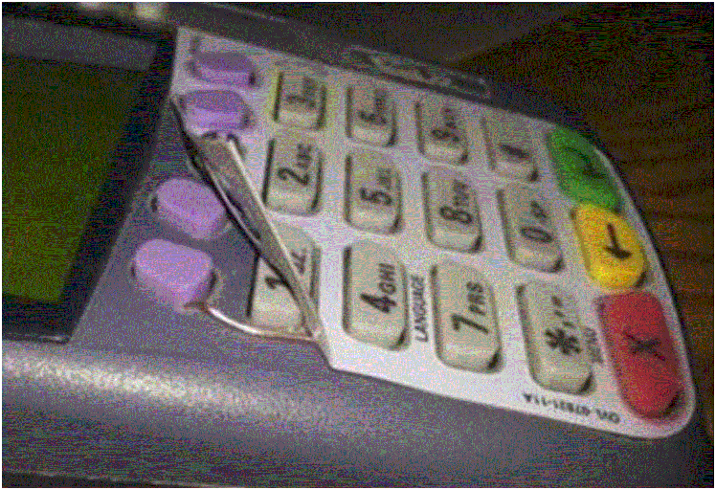
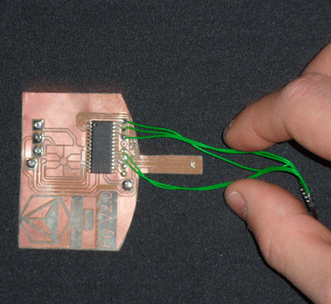
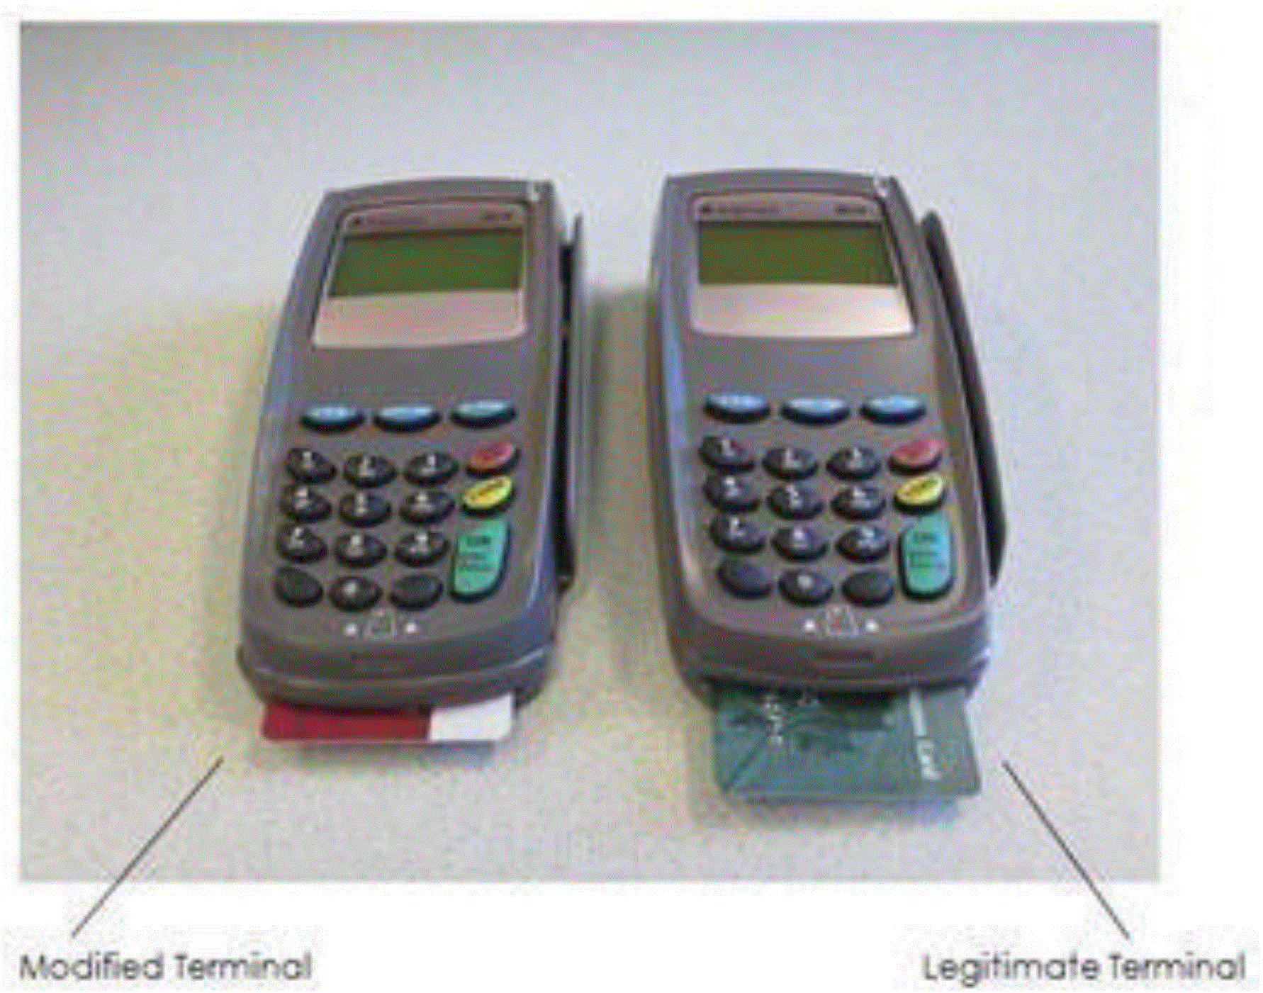
Identifying POS Terminal Fraud
Examples of skimming devices added to POS terminals
Skimmers can be hidden by the SIM card cover plate and by overlays, or stickers that cover the keyboard area and can hide damage due to tampering, as well as wires that allow for keyboard logging.

Slide 18
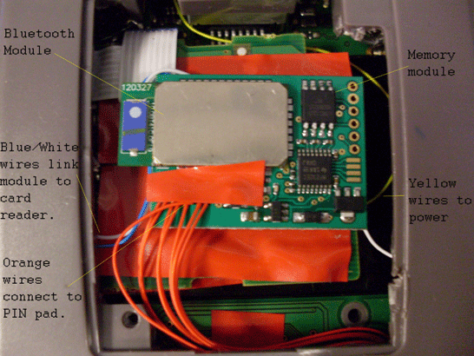
Identifying POS Terminal Fraud
Example of a modification to the POS circuit board
This skimmer has been soldered to the based of the existing circuit board. The blue and white wires leading from the skimmer connect the skimmer to the card reader on the POS device, while the orange wires connect directly to the PIN pad. The Bluetooth module routes the CHD to the attacker.

Slide 19
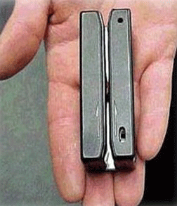
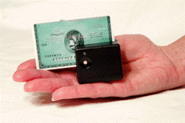
Identifying POS Terminal Fraud
Examples of handheld skimmers
These small, handheld devices, often used by corrupt staff, can store a large amount of CHD and can connect to mobile devices.

Slide 20
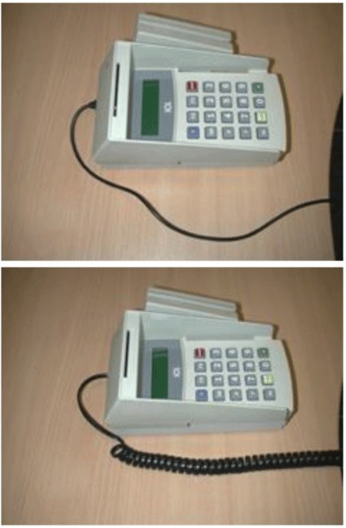
Identifying POS Terminal Fraud
Example of terminal connection change
Normal terminal connection cable
Changed cable houses additional wires to capture CHD

Slide 21
Identifying POS Terminal Fraud
Remember that you are looking for signs of tampering or substitution, but you should not open the device yourself.
Inspect terminals often to ensure there are no new stickers (could be overlays!) or that original stickers have not been removed or modified.
Inspect terminals often to see if the serial numbers are correct.
Inspect terminals often for broken or different colored casings, as well as loosened or missing screws.

Slide 22
Identifying POS Terminal Fraud
Inspect terminal connection cables often for any signs of tampering.
Verify the identity of anyone claiming to be a maintenance or repair person there to work on your POS device.
Verify who called prior to granting access to the device.
Do not install, replace, or return devices without authorization.
Report suspicious behavior around POS devices.
Be aware of anyone handling, unplugging, or opening the device.
If you suspect your POS terminal has been tampered with in any way, please contact the UTSA ISO immediately.

Slide 23
Protecting POS Devices
Go through the Treasurer’s Office for ordering POS devices.
The Treasurer’s Office has a list of approved devices.
Devices ordered through the Treasurer’s Office will be pre-programmed by Elavon.
Keep terminals secured when not in use.
If terminals are in a public location, never leave them unmanned or unattended.
Regularly inspect the devices.
The more the device is used, the more often it should be inspected.
If the device is rarely used, always inspect before the next use.
Have more than one person responsible for inspection.

Slide 24
Protecting POS Devices
Keep your inventory of POS devices current.
Use the PCI DSS Inventory Log found at http://security.tennessee.edu/pci-dss-compliance-information/.
This log should include each person who is approved to use the devices.
Employees shall review this training regularly and new employees must review prior to having access to terminals.
Allow employees role-based access to the terminals.
If access is not needed, access should not be authorized.
Access should be removed immediately upon termination of employment.

Slide 25
Annual Obligations
Complete PCI Security Awareness Training
Documentation
Internal policies and procedures (update as needed)
Policy FI0311
Other pertinent UT policies
Update Inventory
Update list of devices
Update who is explicitly authorized to use devices
Remember to remove access immediately when an employee terminates
Remember to remove access if an employee no longer needs it
Get management authorization each time inventory is updated
Label devices to identify owner, contact info, and purpose

Slide 26
Review
Overview of PCI DSS
PCI DSS Compliance
Merchants’ Roles and Responsibilities
Identifying and Reporting Data Breaches
Identifying Fraud and Protecting the POS
Merchants’ Annual Obligations

Slide 27
If you have questions, comments, or concerns,
please contact Sandy Lindsey at sandy@tennessee.edu or (865) 974-8907.
Updated PCI resources are available on the
PCI Compliance website:
http://security.tennessee.edu/pci-dss-compliance-information/

Slide 28
Training Verification
For each merchant, every employee involved in the processing of cardholder data must complete training as part of the formal PCI Security Awareness Training.
For your official verification of the training, you will need to answer the three short questions in this Qualtrics survey:
https://utk.co1.qualtrics.com/SE/?SID=SV_eOKUKt2rSP96B7v
This verification will be documented and kept on file with the UTSA ISO should you need it in the event of an audit.

